Slide 1
WICA-HTTP and WICA-JS
Simon Rees :: Software Developer :: Paul Scherrer Institut
Two components for bringing PSI’s EPICS control system data to the web
Prepared originally for EPICS Collaboration Meeting ITER June 2019. Updated: September 2019.

Slide 2
Project Motivations
Primary Goal – Status Display Replacement
“Replace the displays which show the status of PSI’s main facilities with something that scales better to the future.”
Minimum Requirements
Provide a tool for PSI’s offsite technical staff -> should allow them to verify that the scientific facilities are working correctly.
Provide a tool for PSI remote users -> should allow them to see how the program of work is evolving (so they can decide whether to come on-site)
Improved User Experience -> should provide a “fancier”, more responsive user interface that work equally well on desktop, tablet and mobile devices. Buzzword: “PWA’s.
Secondary Goal – Learn Lessons
“Explore the difficulties of achieving the above by leveraging off powerful, modern, well-tested and widely-used web frameworks and libraries.”

Slide 3
Solution Summary
A new solution has been developed called “WICA”.
WICA stands for Web Interface for Controls Applications. (The CA previously stood for “Channel Access”, but the intention is to make the library compatible with newer control system protocols when/if we actively use them).
WICA consists of:
WICA-PAGES: these are standard HTML5 webpages that leverage off user-defined ‘data-wica-*’ attributes to configure the control system channels of interest and to define other properties needed to render the element.
WICA-HTTP: this is an HTTP microservice which provides a means of getting, setting and/or streaming live data from an EPICS-based control system.
WICA-JS: this is a Javascript library which scans the WICA webpages, sets up a live data stream from the WICA-REST server and which updates the visual appearance of the elements in real time.
WICA can render the textual content of html elements directly, or can work with other JS libraries (eg plot libraries like Plotly, Highcharts or web component libraries like LitElement) where more sophisticated functionality is required.

Slide 4





WICA Overview Picture
An HTTP/EPICS gateway for accessing live control system data.
Serves EPICS live status information via HTML5 Server Sent Event (SSE) data stream.
Control System
IOC
http (POST, GET)
WICA-HTTP
Server
CA (get, monitor)
IOC
IOC
Provides the status display webpages for the control system users
Web Browser
(desktop, tablet, mobile…)
Web Server
WICA Web Pages
Uses HTML, CSS, Javascript to define the structure, appearance and dynamic behavior of the control system webpages.
Uses data-wica-* attributes to make the webpages “control system aware”.
http (GET)
WICA Web Pages
WICA-JS
Users
Observation: most of this technology is given to us “for free”– the goal is NOT to write lots of software!
A JS library for updating control system web pages, using data received from the WICA-HTTP service.
Renders the browser’s webpage to reflect live values received from the WICA-HTTP service.

Slide 5
Simple Wica Web Page Example
<!doctype html> <html lang="en"> <head> <meta charset="utf-8"/> <title>Wica Demo Page</title> <script src="/wica/wica.js" type="module"></script> </head> <body> <h1>Wica Demo Page</h1> <label>Channel-1:</label> <span data-wica-channel-name="SINEG01-MBND300:I-READ"></span> <br> <label>Channel-2:</label> <span data-wica-channel-name="SINLH02-MBND100:I-READ"></span> <br> <label>Channel-3:</label> <span data-wica-channel-name="SINBC02-MBND100:I-READ"></span> <br> </body> </html>

Slide 6
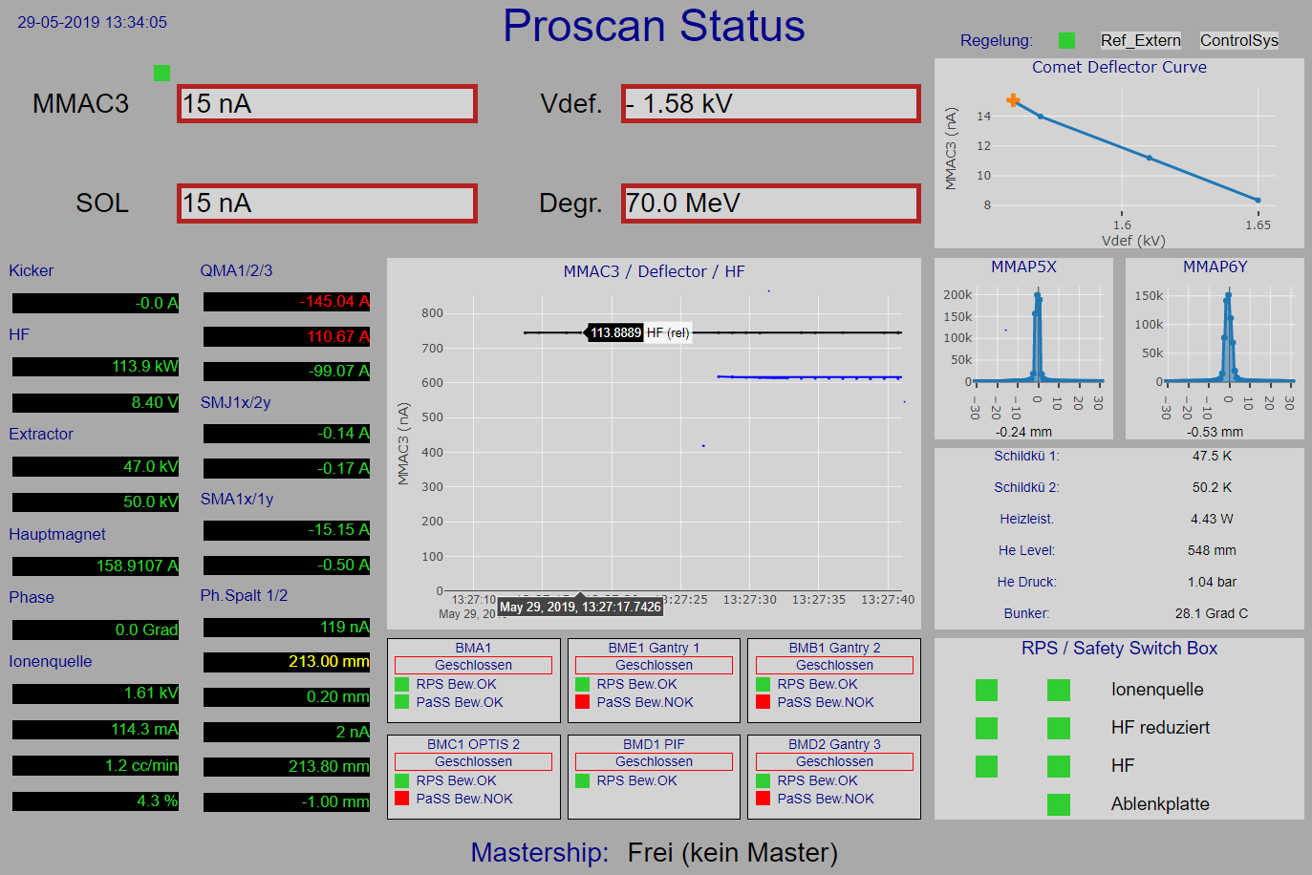

More Complicated Example: Goal was to make it as ugly as the original ! ;-)
Integration with 3rd party libraries (eg Plotly, Web Components) is possible.

Slide 7
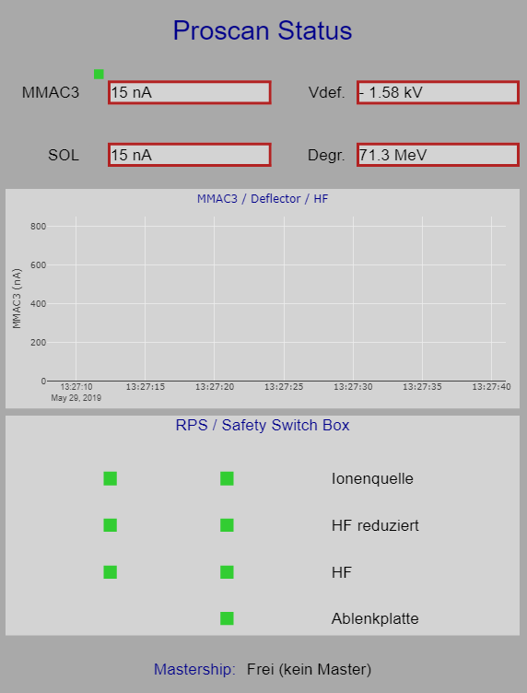
Because the pages just use normal web technology we can use CSS media queries to change the formats according to the features of the viewing device…

Slide 8
WICA-HTTP Service: an HTTP/EPICS Gateway
The WICA HTTP Service supports HTTP operations (POST, PUT, GET, DELETE) on two information resources that map onto the underlying control system: ‘Channel’ and ‘Stream ‘.
‘Channel’ means EPICS channel. ‘Stream’ is a collection of channels which can be aggregated together and sent down the wire as a single HTML5 Server-Sent-Event (SSE) message.
The implementation is based on Java Open JDK (11) and Spring Boot (2.1). The use of Spring Boot, particularly has a big impact on reducing the amount of code that needs to be written. Communication with the EPICS Control System is achieved using the PSI-funded Java CA client library (written by Matej Sekoranja, CosyLab).
At PSI the server is deployed in a Docker Container. We hope this will provide an easier migration path for scaling the solution upwards should the load become excessive.

Slide 9
WICA-HTTP Service - Create Stream
Command: ‘Stream Create’
This command takes an array of channel names and returns a <stream_id> which can be used later for subscription purposes. Optional properties provide finer-grained control over the data when it is streamed.
What the backend server does:
creates EPICS channels to obtain data from the IOCs on the backend control system
obtains the EPICS channel metadata (type, alarm and control limits, etc.)
establishes an EPICS ca monitor on each channel and begins to cache the received values.
Additional Options:
control over the precision of the streamed data.
control over the rate at which information is sent down the stream.
control over whether the stream contains polled or monitored data.
control over various types of filtering.
POST http://localhost:8080/ca/streams Content-Type: application/json { "channels" : [ { "name": "wica:test:counter01", "props": { "daqmode": "monitor" } }, { "name": "wica:test:counter02", "props": { "daqmode": "poll", "pollint": "5000" } }], "props" : { "prec": 2, "hbflux": "8000", "monflux": 1000, "pollflux": 2000 } }
Returns a new <streamId>, a unique string which can be used subsequently for subscribing.

Slide 10
WICA-HTTP Service – Subscribe to Scream
Command: ‘Stream Subscribe’
This command takes a <stream_id> and returns the corresponding live data stream.
What the backend server does:
Returns a continuous stream of server-sent event messages with the following message types:
channel-metadata: for all channels in the stream – sent once.
channel-monitored-values: includes information on monitored channels which have changed – sent periodically (at a configurable rate).
channel-polled-values includes information on polled channels which have changed - sent periodically (at a configurable rate).
stream-heartbeat: a message which the WICA-JS library uses to detect loss of the connection – sent periodically.
GET /ca/streams/<streamId>
Returns the HTML5 Server-Sent-Event Stream (SSE) for the specified <streamId>.

Slide 11
WICA-REST Service – Stream Messages
Example Stream Messages:
id:3 event:ev-wica-channel-metadata data:{"wica:test:counter01":{"type":"REAL","egu":"","prec":0,"hopr":0.00,"lopr":0.00,"drvh":0.00,"drvl":0.00,"hihi":NaN,"lolo":NaN,"high":NaN,"low":NaN}} :2019-09-08 17:30:28.181 - channel metadata
id:3 event:ev-wica-channel-value data:{"wica:test:counter01":[{"sevr":"0","val":11042.00}]} :2019-09-08 17:30:29.085 - channel monitored values
id:3 event:ev-wica-channel-value data:{"wica:test:counter02":[{"sevr":"0","val":61077.00}]} :2019-09-08 17:30:34.077 - channel polled values
id:3 event:ev-wica-server-heartbeat data:2019-09-08T17:30:36.078750 :2019-09-08 17:30:36.078 - server heartbeat

Slide 12
WICA-REST Service Commands – Channel Get / Put
Commands: ‘Channel Get’ and ‘Channel Put’
These commands offer a very simple channel get/put capability.
What the backend server does:
creates an EPICS CA channel to the process variable on the EPICS control system.
performs a synchronous, (= “confirmed”) GET/PUT operation, returning/using the obtained/supplied value.
Additional Options:
Control over the timeouts for the getting or putting the data.
GET /ca/channels/<channelName>[?timeout=XXX][]
Returns a JSON string representation of the value of the channel. For a channel whose underlying data source is EPICS the returned information looks like this:
{"type":"STRING","conn":true,"val":"15.101","sevr":0,"stat":0,"ts":"2019-03-06T09:37:22.103198","wsts":"2019-03-06T09:37:22.103211","wsts-alt":1551865042103,"dsts-alt":1551865042103}
PUT /ca/channels/<channelName>
Content-Type: text/plain the new value
Somevalue
Returns a string “OK” when the put was successful.

Slide 13
WICA-JS Library
The WICA-JS library is loaded after the rest of the webpage to scan the source document for elements that are ‘’wica-aware” (= elements whose 'data-wica-channel-name' attribute is set).
The library then collaborates with the WICA-REST server to stream back the channel metadata (eg alarm and display limits) and changing channel values, setting the following attributes to match the received data:
Attribute | Description
data-wica-stream-state | Contains status of connection to Wica Server.
data-wica-channel-connection-state | Contains status of connection to data source.
data-wica-channel-alarm-state | Contains alarm status of data source.
data-wica-channel-metadata | Contains last received metadata from data source.
data-wica-channel-value-latest | Contains last received value from data source.
data-wica-channel-value-array | Contains array of latest received values from data source.

Slide 14
Lessons Learned so far…
Creating Flexible, Modern, Responsive, Beautiful webpages for today’s web that integrate with our control system data is now possible. ☺
But… leveraging off the possibilities of the today’s modern web doesn’t come cheap… there is a lot of extra information to think about when trying to build responsive, scalable layouts.
Whatever format we choose (.medm, .ui, .html) there will always be a lot of extra information to capture that before our lab did not really care about…
Tooling would be useful, but web designers seem to prefer hacking html and Javascript than using the builder tools that have been common in the EPICS community. To make a solution with wide applicability to our users we would need them.
Fortunately “incompatible browser syndrome” is less of a problem these days… however Internet Explorer (and their newer browser Edge) are still outside the web community and likely to remain so. At our Lab we mainly ignore them. (JS Libraries such as Modernizr can assist in autodetecting incompatibilities and providing a hint to the user if the browser does not adequately support the required features).

Slide 15
Project Next Steps
Consolidation
Complete WICA-RELAY -> access webpages from internet whilst satisfying PSI’s internet security guidelines.
Complete rollout of displays for all PSI’s scientific facilities.
Publish WICA-HTTP and WICA-JS to web (if there is interest).
Improve the User Experience
“Make further improvements that take advantage of the capabilities offered by our new enabling technologies (Spring Boot, Lit-Element, modern JS)”
Possibility to include Epics status information in any web page.
Create webpages that comply with the requirements of PSI’s communication department
Provide status displays usable from other devices (tablets, phones, wearables…)
Future
Consider whether a GUI Build Tool would be viable.
Consider whether an import tool would be viable (PSI’s PEP tool at least should be straightforward)

Slide 16
Thanks for your attention ! ☺
Thanks go to:
Simon Ebner
Daniel Lauk
And especially:
Dirk Zimoch (for giving this talk)
For questions on this work please contact:
Simon Rees - simon.rees@psi.ch or
Simon Ebner - simon.ebner@psi.ch

Slide 17
Use of Modernizr JS library to autodetect any browser compatibility issues.
Not looking at any companies anywhere in particular (Seattle)…

Slide 18
Goals and Non-Goals
Provide an HTTP REST (micro)service for accessing PSI’s EPICS-based control system from the web.
Make it easy for users to create HTML pages that show the evolving live status of the control system.
Explore some of the issues involved in bringing the control system’s user-interface to the web.
Currently Not a Goal: provide a general-purpose replacement for PSI’s caQtDM display-building technology. (two essential components are still missing: design tool, conversion tool).

Slide 19
Concrete Use Case - 2
Provide EPICS Microservice for Snapshot Tool

Slide 20
Implementation -1
General principle: consolidate our future solutions based on technologies that are the unquestionable standard in any serious IT companies. Everything has moved to the web… “no-one develops applications for the desktop any more”.
Leverage off the general availability of powerful, highly scalable, open source frameworks to write the minimum code possible.

Slide 21
PSI Colour Scheme
PSI‘s basic colours
Colour options for graphs: 1st choice
Colour options for graphs: 2nd choice

